Slide 1
Correlations
SSI II
February 7, 2018

Slide 2
Previously…
Bivariate hypothesis tests
Two categorical variables
One categorical and one continuous variable

Slide 3
Essential Questions
What do correlation and pearson’s r tell us (and not tell us)?

Slide 4
Which Bivariate Test?
 |  | Independent Variable Type
Dependent Variable Type |  | Categorical | Continuous
 | Categorical | Tabular Analysis | Probit/Logit
 | Continuous | Difference of Means | Correlation Coefficient; Bivariate Regression Model

Slide 5
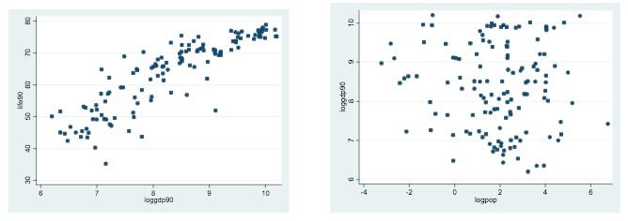
Continuous Variables
Independent and dependent variables are both continuous
We need to summarize the covariation between the variables
When X increases, does Y also increase, decrease, or is there no systematic pattern?

Slide 6
Spousal Age Example
Do people tend to marry other people of the same age?
Our experience tells us “yes,” but how good is the correspondence?
Notes:
Let’s begin by asking if people tend to marry other people of about the same age. Our experience tells us “yes,” but how good is the correspondence?

Slide 7
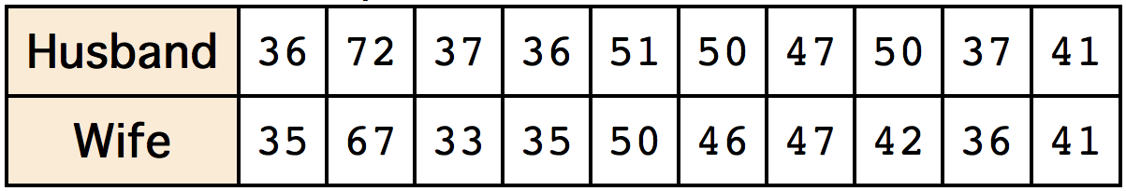
Spousal Age Example
One way to address the question is to look at pairs of ages for a sample of married couples.
The table shows the ages of 10 married couples.
Notes:
One way to address the question is to look at pairs of ages for a sample of married couples. The table shows the ages of 10 married couples.

Slide 8
Spousal Age Example
Husbands and wives tend to be about the same age
Men having a tendency to be slightly older than their wives.
Notes:
Going across the columns we see that, yes, husbands and wives tend to be of about the same age, with men having a tendency to be slightly older than their wives. This is no big surprise, but at least the data bear out our experiences, which is not always the case. The pairs of ages in the table are from a dataset consisting of 282 pairs of spousal ages, too many to make sense of from a table.

Slide 9
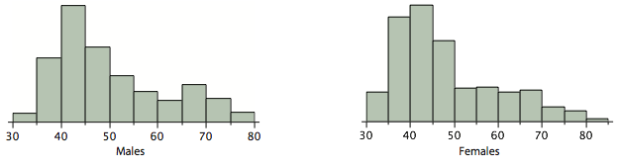
Spousal Age Example
Notes:
What we need is a way to summarize the 282 pairs of ages. We know that each variable can be summarized by a histogram and by a mean and standard deviation. Each distribution is fairly skewed with a long right tail. Although some wives are older than their husbands, this information cannot be determined from the histograms or from the means and standard deviations.

Slide 10
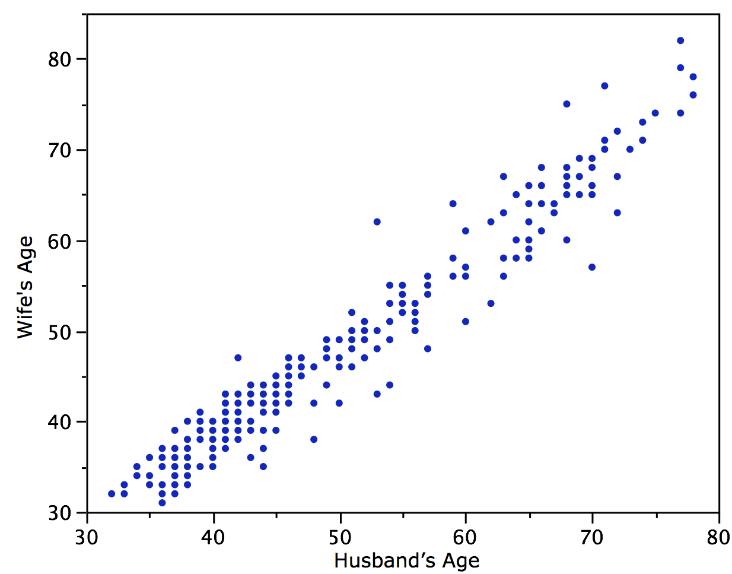
Notes:
We can learn much more by displaying the bivariate data in a graphical form that maintains the pairing. The figure shows a scatter plot of the paired ages. The x-axis represents the age of the husband and the y-axis the age of the wife. Each blue dot represents one married couple. The graph shows clearly that there is a strong relationship between the husband’s age and the wife’s age: the older the husband, the older the wife

Slide 11
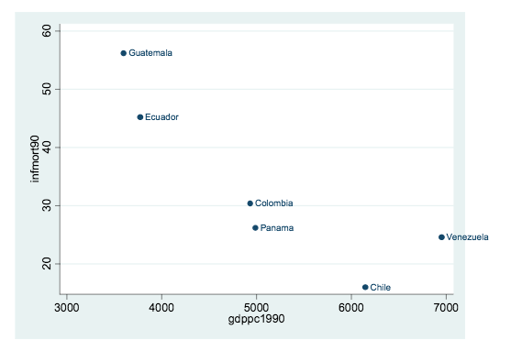
Continuous Variables
Question: Is infant mortality lower in wealthier countries?

Slide 12
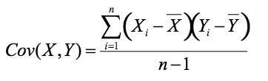
Covariance
A measure of linear association between X and Y
Compute the mean for each variable
Compute the (signed) deviations from the mean of X and for Y for each observation
Multiply the X deviation and the Y deviation for each observation
Add them all up and divide by the total number of observations minus 1

Slide 13
Covariance
Step 1: Calculate the mean for each variable
Country | Y (Infant Mortality) |  | X: (GDPpc 1990)
Chile | 16 |  | 6148
Columbia | 30.4 |  | 4934
Ecuador | 45.2 |  | 3774
Guatemala | 56.2 |  | 3598
Panama | 26.2 |  | 4989
Venezuela | 24.6 |  | 6952
Mean= | 33.1 |  | 5065.8

Slide 14
Covariance
Step 2: Calculate deviations from the mean for each variable and observation
Country | Y (Infant Mortality) | Y_{i}-Ȳ | X: (GDPpc 1990) | X_{i}-X̅
Chile | 16 | -17.1 | 6148 | 1082.2
Columbia | 30.4 | -2.7 | 4934 | -131.8
Ecuador | 45.2 | 12.1 | 3774 | -1291.8
Guatemala | 56.2 | 23.1 | 3598 | -1467.8
Panama | 26.2 | -6.9 | 4989 | -76.8
Venezuela | 24.6 | -8.5 | 6952 | 1886.2
 | 33.1 |  | 5065.8

Slide 15
Covariance
Step 3: Calculate the product of the deviations for each observation
Country | Y (Infant Mortality) | Y_{i}-Ȳ | X: (GDPpc 1990) | X_{i}-X̅ | (X_{i}-X̅)(Y_{i}-Ȳ)
Chile | 16 | -17.1 | 6148 | 1082.2 | -18505.6
Columbia | 30.4 | -2.7 | 4934 | -131.8 | 355.9
Ecuador | 45.2 | 12.1 | 3774 | -1291.8 | -15630.8
Guatemala | 56.2 | 23.1 | 3598 | -1467.8 | -33906.2
Panama | 26.2 | -6.9 | 4989 | -76.8 | 529.9
Venezuela | 24.6 | -8.5 | 6952 | 1886.2 | -16032.7
 | 33.1 |  | 5065.8

Slide 16

Covariance
Step 4: Calculate the average product (sum across all observations and divide by N-1)
Country | Y (Infant Mortality) | Y_{i}-Ȳ | X: (GDPpc 1990) | X_{i}-X̅ | (X_{i}-X̅)(Y_{i}-Ȳ)
Chile | 16 | -17.1 | 6148 | 1082.2 | -18505.6
Columbia | 30.4 | -2.7 | 4934 | -131.8 | 355.9
Ecuador | 45.2 | 12.1 | 3774 | -1291.8 | -15630.8
Guatemala | 56.2 | 23.1 | 3598 | -1467.8 | -33906.2
Panama | 26.2 | -6.9 | 4989 | -76.8 | 529.9
Venezuela | 24.6 | -8.5 | 6952 | 1886.2 | -16032.7
 | 33.1 |  | 5065.8 |  | -83189.5

Slide 17

Correlation Coefficient
The correlation coefficient (also known as Pearson’s r) rescales the covariance by dividing by the standard deviations of X and Y

Slide 18
Correlation Coefficient
Correlation ranges from -1 to 1
Positive correlation - if observations fall on a perfectly straight line with positive slope, the correlation is 1
Negative correlation – If observations fall on a perfectly straight line with negative slope, the correlation is -1
No correlation – if observations fall on a straight horizontal or vertical line, the correlation is 0

Slide 19
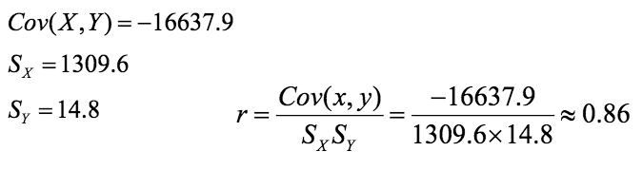
Correlation
Divide the covariance by the standard deviation of X and the standard deviation of Y
Example

Slide 20
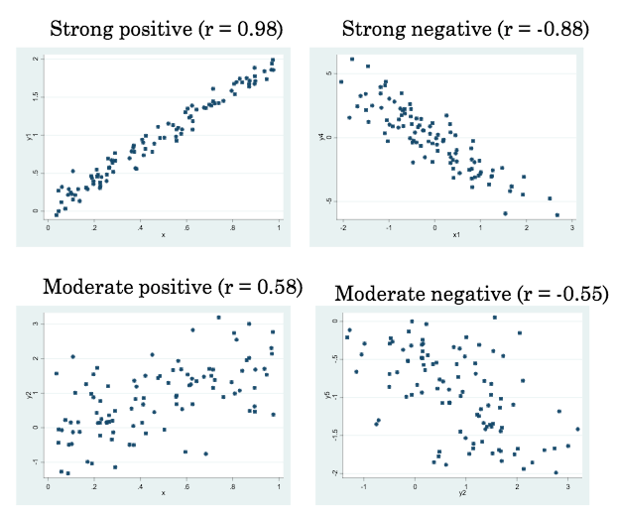

Slide 21
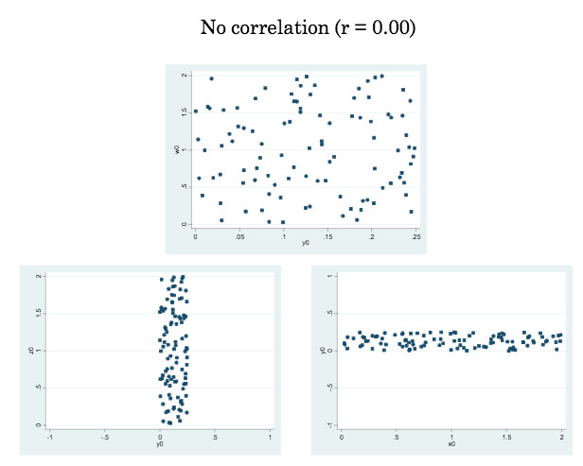

Slide 22
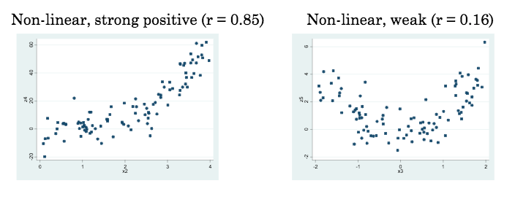

Slide 23
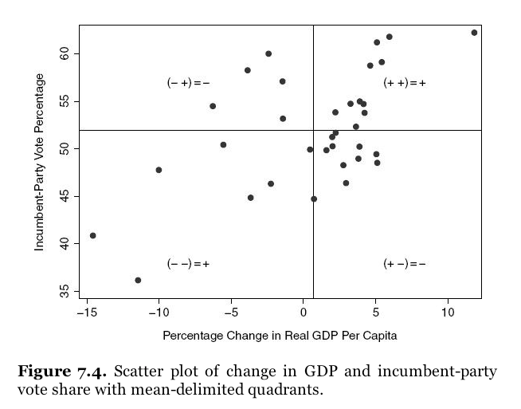
Notes:
Source: Kellstedt and Whitten, The Fundamentals of Political Science Research

Slide 24
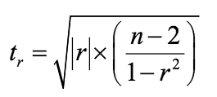
Significance Tests for Correlations
t-statistic for correlation coefficient
Follows t distribution with n-2 degrees of freedom
Note: Use of absolute value implies a two-tailed test

Slide 25
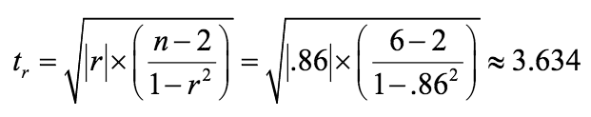
Example: Significance Tests for Correlations

Slide 26
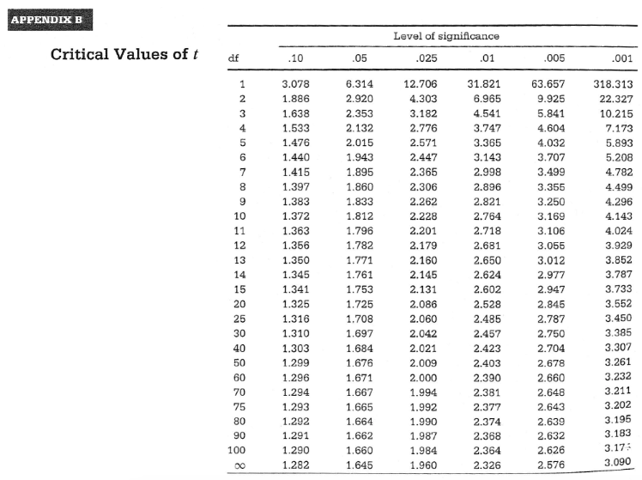

Slide 27
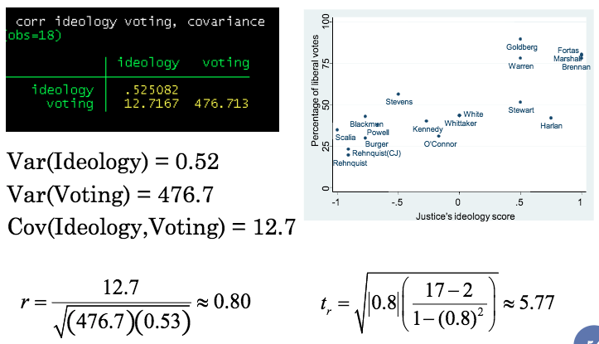
Example 2
3

Slide 29
General Steps in Hypothesis Testing
State null and alternative hypotheses about the population
Calculate the test statistic from a random sample
Compare the test statistic to a critical value or compute the p-value
If the test statistic exceeds the critical value or if the p-value is smaller than the significance level, reject the null hypothesis

Slide 30
Summary
Hypothesis testing relies on principles of statistical inference
Test statistics
How many standard errors is the sample from the hypothesis?
Formulas depend on the type of test
Null hypothesis testing
State null hypothesis (assumed true) and an alternative hypothesis
Calculate test statistic
Reject null hypothesis in favor of the alternative or fail to reject the null
p-value represents the probability of observing a given statistic if the null hypothesis is true

Slide 31
Essential Questions
What do correlation and pearson’s r tell us (and not tell us)?

Slide 32
Next Time…
Bivariate regression
Another option for two continuous variables

